Slide 1
FLIGHT FARE PREDICTION
Prepared by : Nurfarah Izzati binti Ahmad Yusoff

Slide 2
PROJECT OVERVIEW
PROBLEM STATEMENT
Flight ticket prices can be something hard to guess, today we might see a price, check out the price of the same flight tomorrow, and it will be a different story.
OBJECTIVE
To help airlines and travel industries to set a price system to grow their business
To predict the flight ticket price for users to plan their journey accordingly and select best-suited flight

Slide 3
PROJECT OVERVIEW
Data Acquisition
Data cleaning & pre-processing
Separating target and variable features
Train Test Data
Fitting model using
Random Forest

Slide 4
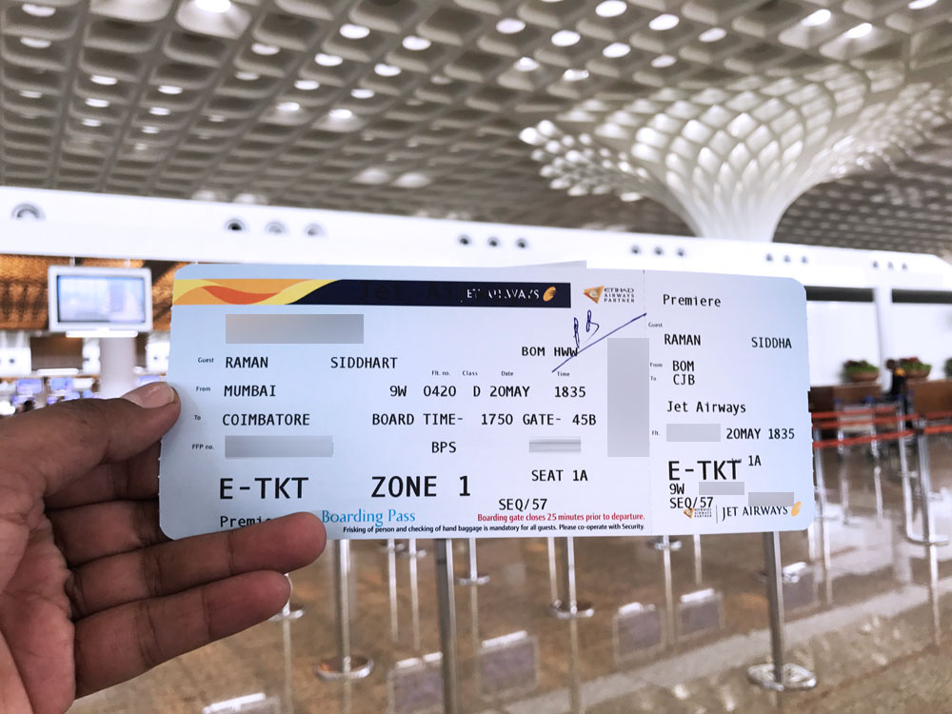
PROJECT OVERVIEW
Dataset source : https://www.kaggle.com/datasets/riteshbagdi/flight-fare-prediction-dataset/data?select=Data_Train.xlsx
Airline
Date of Journey
Source (Depart)
Destination
Route
Departure Time
Arrival Time
Duration
Total Stop
Additional Info
Price
Flight Ticket of Jet Airways. Image source : Siddharth. Jet Airways Premiere – Boarding Pass, 2021. Accessed via : https://www.cardexpert.in/jet-airways-domestic-business-class-review/

Slide 5
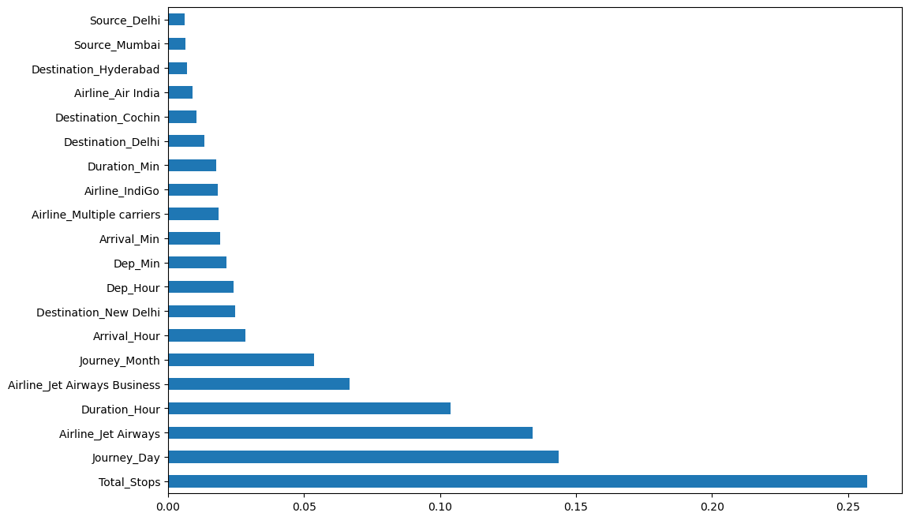
RESULTS ANALYSIS
Figure 1. Feature Importances

Slide 6
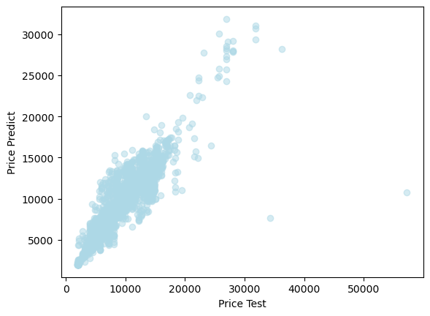
RESULTS ANALYSIS
MSE (Means Squared Error ) :
Train = 996319.8634187641, Test = 4390681.869211171
RMSE (Root Means Squared Error) :
Train: 1002.506955505855 Test: 2097.3403719620633
Accuracy, R²(R squared score) :
Train: 0.9525700193956842 Test: 0.7959917843766708
(95.26%, 79.60%)
Figure 2. Graph of Price Predict vs Price Test

Slide 7
Reference
Use latest APA style referencing

Slide 8
Thank you

Slide 9
Appendix

